Slide 1
Bloomberg orderbook project
Nicolas Luk

Slide 2
Types of subscription
Simple subscription (free/Bloomberg QR)
Necessary to match a trade
Gives: Last traded price, last traded time and last traded size
B-PIPE
Market by Order (MBO/Bloomberg Order Book):
Gives you update about current position of the order book, gives information
e.g. Price, Position, Size, Order ID
Top Broker (TOP/Bloomberg Broker Book):
Gives you update about the broker position
e.g. Price, Position, Broker Code

Slide 3
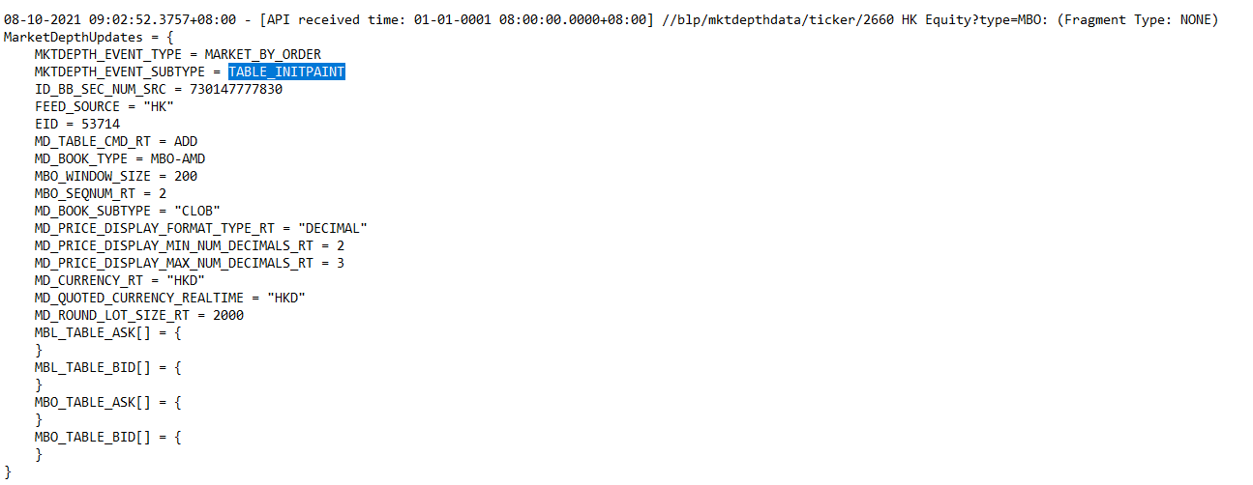
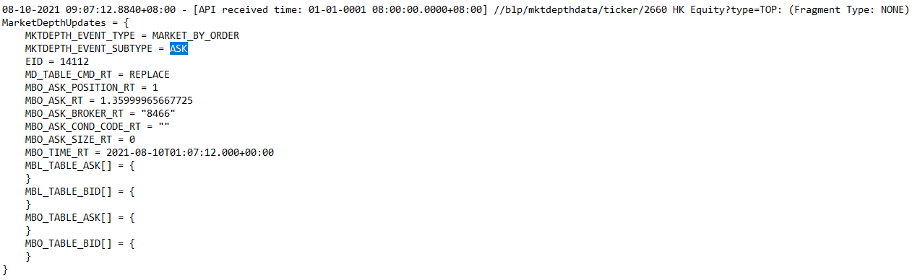
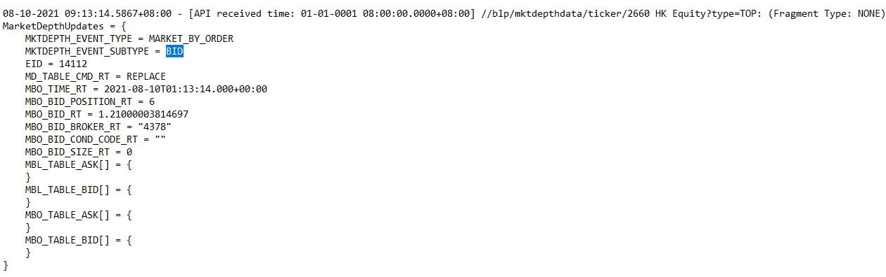
Message Type (BPIPE) – MKTDEPTH_EVENT_SUBTYPE
Table Message (TABLE_INITPAINT)
Gives information of the current table
Will be empty if subscribe before market opens
2 table messages per stock, 1: TOP, 2:MBO
Updates (MBO and TOP)
Gives the latest status of a specific position
Only give 1 position information per message

Slide 4
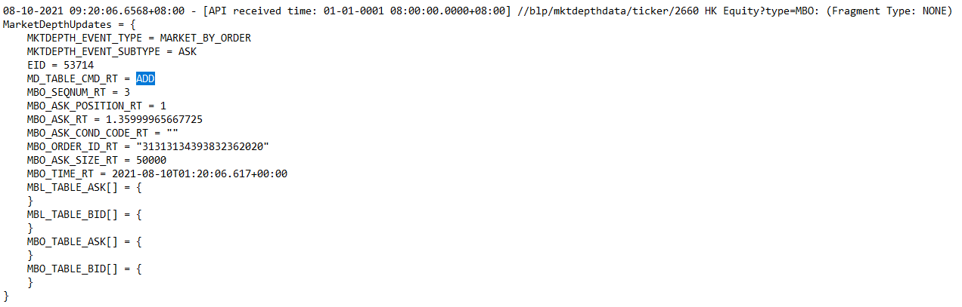
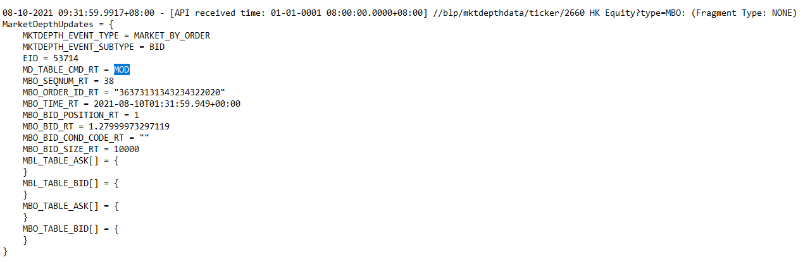

Update Message – MBO Updates
When there’s any movement in the order book, multiple messages will be sent
Movement includes:
ADD - Submitted a new order
MOD - Modified an existing order
DEL - Cancelled an order
DEL - An Order was filled
Position, Price, Size, time will be extracted

Slide 5
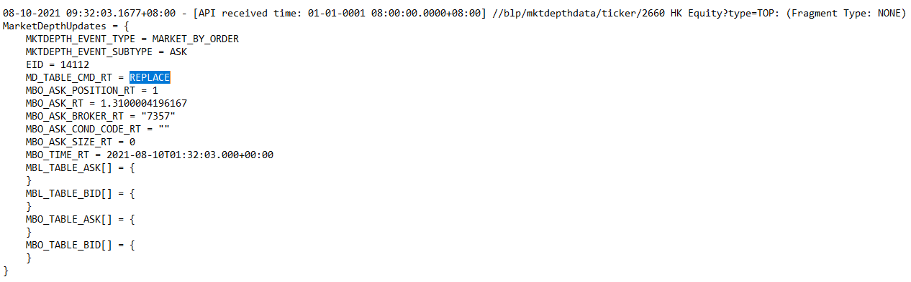
Update Message – TOP Updates
Movements:
REPLACE – Replaces the existing position with the updated broker and price
(This does not give any information about the size)
Price and Broker code and time will be extracted

Slide 6
Code logic – Read message (No trade)
Delete history
If message is: MBO DEL
All activities:
Event log
MBO
(ADD,MOD,DEL)
Update messages
Read
Read messages and update table
MBO: ADD/DEL/MOD
TOP: REPLACE
TOP
(REPLACE)
(MBO/TOP) -(BID/ASK) Table
Table messages
Message
Code
File
Notes:
Read and record message
Initialize table
Update table
Match transactions

Slide 7
Code logic – Read message (Trade)
Only when there is a trade:
QR
Trade history
Delete history
If message is: MBO DEL
All activities:
Event log
MBO
(ADD,MOD,DEL)
Update messages
Read
Read messages and update table
MBO: ADD/DEL/MOD
TOP: REPLACE
TOP
(REPLACE)
(MBO/TOP) -(BID/ASK) Table
Table messages
Message
Code
File
Notes:
Read and record message
Initialize table
Update table
Match transactions

Slide 8
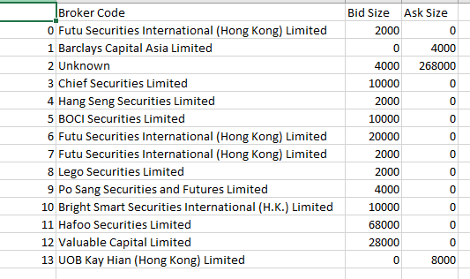
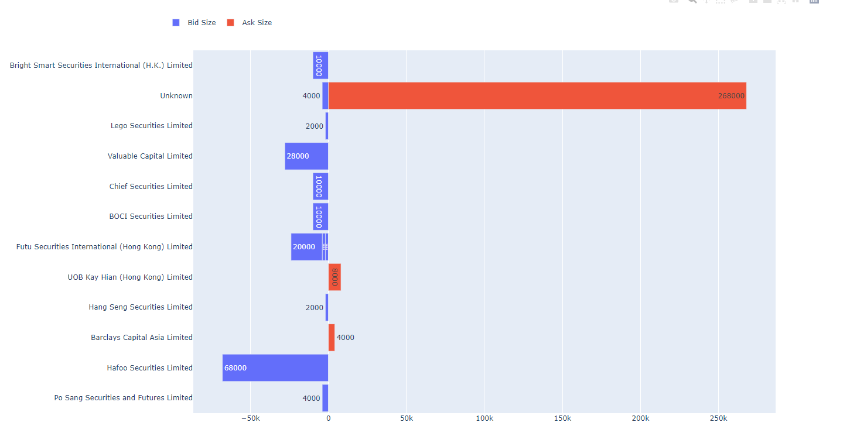
Code logic - Match
Match
Trade history
Delete history
Message
Code
File
Notes:
Read and record message
Initialize table
Update table
Match transactions

Slide 9
Code logic – Overall
Only when there is a trade:
Match
QR
Trade history
Delete history
If message is: MBO DEL
All activities:
Event log
MBO
(ADD,MOD,DEL)
Update messages
Read
Read messages and update table
MBO: ADD/DEL/MOD
TOP: REPLACE
TOP
(REPLACE)
(MBO/TOP) -(BID/ASK) Table
Table messages
Message
Code
File
Notes:
Read and record message
Initialize table
Update table
Match transactions

Slide 10
End result
From the graph, we can see Hafoo Securities is the top buyer which bought 68,000 shares

Slide 11
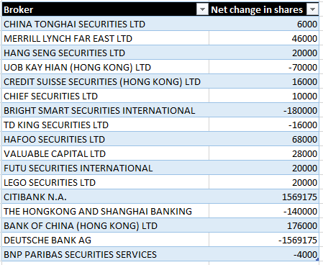
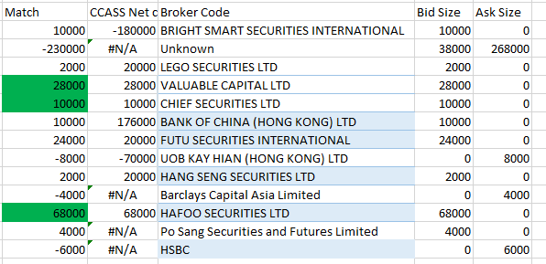
Checking (Matching results)
Compared with CCASS (Left) which shows the net change in brokers share holding on 12/8/2021, the code was able to identify 3 broker’s activities.
The reason of discrepancy is due to:
Some broker would not be able to be identified if the delay between an order being submitted and an order being filled is too small. Those brokers would be named as ‘Unknown’
Only half of the broker activity was captured (Broker was identified when buy and was identified as ‘Unknown’ when sell

Slide 12
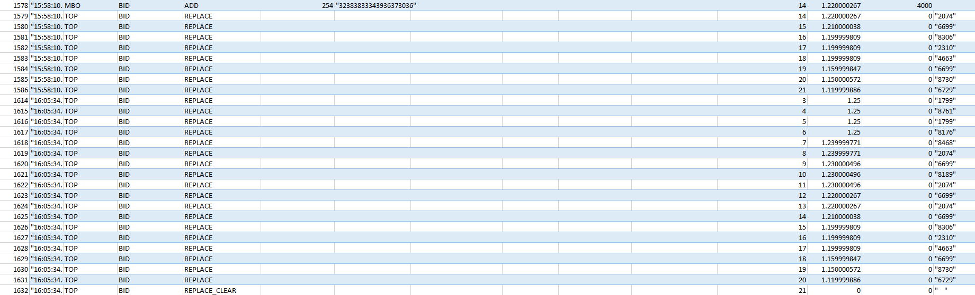
Comments
This code is strongly dependent on the completeness of the message
MBO and TOP should come in a pair, or else there will be a mismatch in mbo & top bid ask table
A MBO-BID (ADD/DEL) is expected as there’s a sudden change in the 3rd position

Slide 13
Comments
Further testing should be conducted when there’s more data available
The current code is based on messages from a text file, some part of the code has to be changed when it comes to application but the logic should be fine
Some trades might not be identified based on message delay, please manually check with del_hist (14:24:02.141)
transaction history (14:24:02.143)

Slide 14
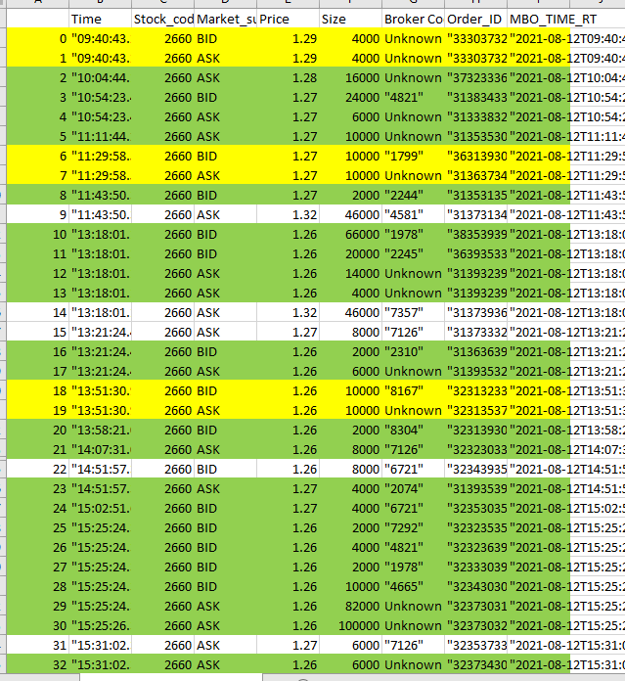
Comments
The volume of the yellow trades is double counted

Slide 15
Remarks
Should remove half of the size when the code captured both sides of the transaction (Yellow examples)
Should plot a graph with different brokers at the same price
Check with Tiffany

Slide 16
Appendix

Slide 17
Store message

Slide 18
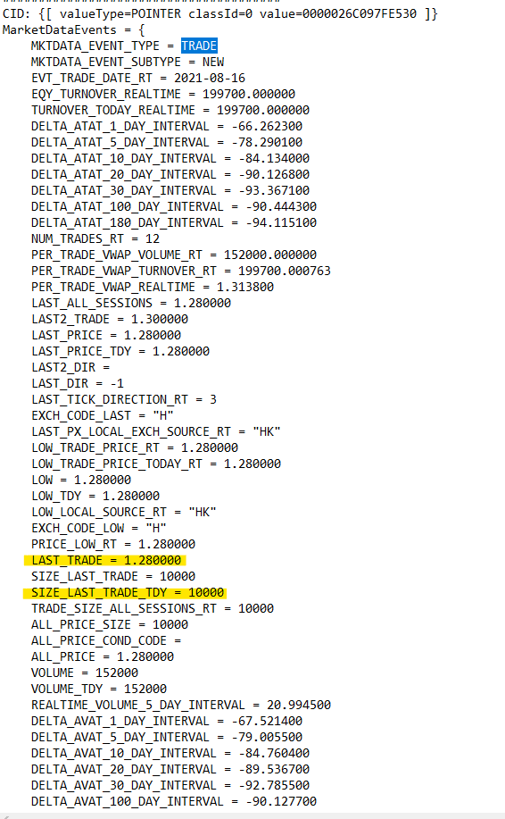
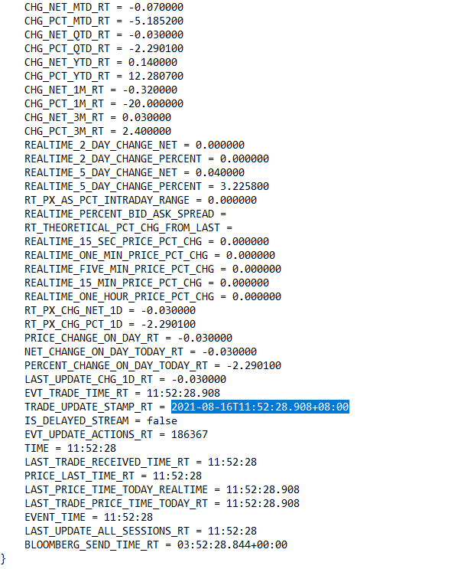
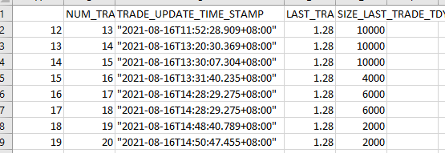
Message format (Simple/Bloomberg QR)
Whenever there’s a trade, a message will be generated, and we extract the last price, last size and transaction time
The trade data will be stored in a csv file
=>{stock_code}HK_data_{date}.csv

Slide 19


Message - Table
The code reads the message and generates 4 tables
{stock_code}_mbo_ask_table_{date}.csv
{stock_code}_mbo_bid_table_{date}.csv
{stock_code}_top_ask_table_{date}.csv
{stock_code}_top_bid_table_{date}.csv
Top table consist of Price, Position and Broker Code
MBO table consist of Price, Position, Size and Order ID

Slide 20
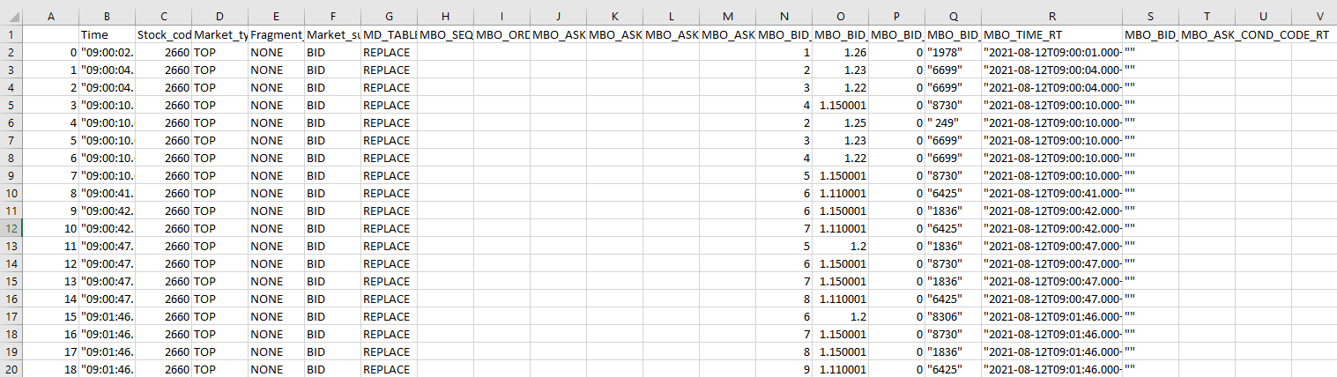
Message
The extracted message will then be stored into a csv file
{stock_code}_event_log_{date}.csv
This could be used to double check whether the code correctly interpret the incoming message or not

Slide 21
Store message and update table

Slide 22
Read event log and update table
MBO table:
ADD: The code adds a new row at the specific position with the price and size to the mbo ask table as ‘MARKET_SUBTYPE” == “ASK” (Price: 1.28, Size: 4000, Position: 1)
MOD: The code modifies the existing position in the mbo bid table as “MARKET_SUBTYPE” == “BID” (Price: 1.28, Size: 20000, Position: 1)
DEL: The code deletes an existing position in ask mbo table (Price: 1.28, Size: 16000, Position: 1), the deleted position will be stored into a delete_history file => {stock_code}_del_hist_{date}.csv

Slide 23
Read event log and update table
TOP table:
REPLACE: The previous position will be replaced by the new one (Position = 4, Price = 1.32, Broker = “7357”)

Slide 24
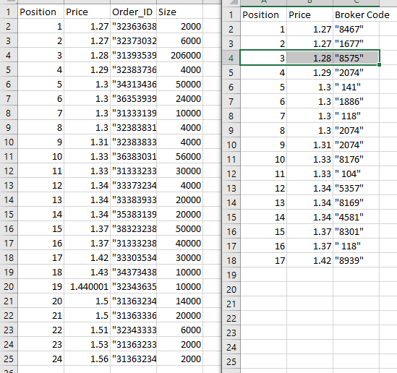
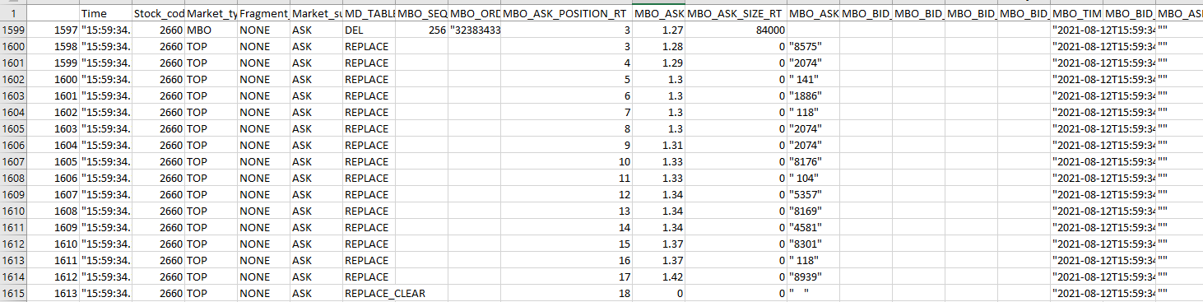
Example
Ask table DEL: Position 3 1.27@84000 was deleted (Left)
New ask position 3 becomes 1.28 with the broker code “8575” (Right)
Broker position below 3 all shifted up

Slide 25
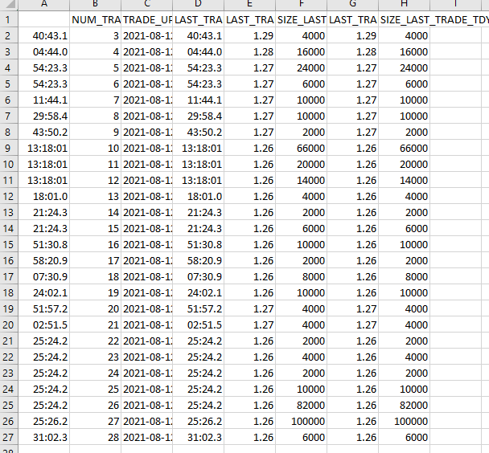
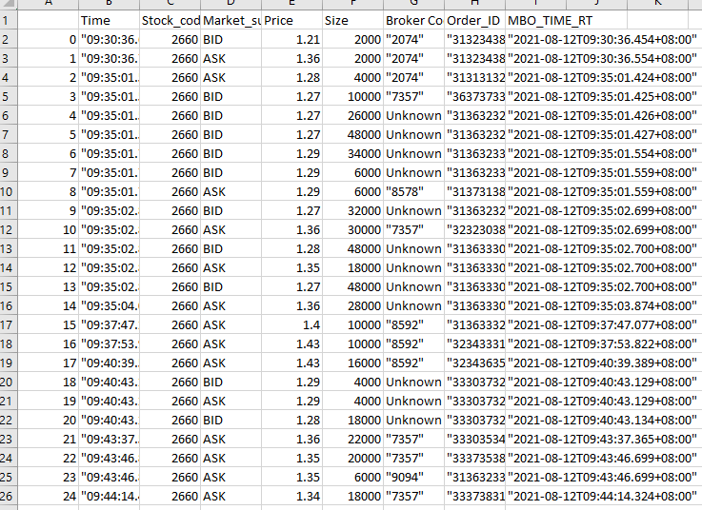
Matching transactions
The code compares the transaction history (left) and the delete history (right)

Slide 26
Matching transactions
The code matches most of the trades and generate a csv file
{self.stock_code}_identified_trades_{date}.csv
*Some trade might not be identified, please check with del_hist
The code will compute a market depth csv

